Slide 1
Neurofeedback Meditation Application
Guide :
Mr. Gouse Pasha
(Asst. Professor)
Team Members :
M.N.S Divya - 20R21A6636
N.Samhitha - 20R21A6642
R.Lohitha - 20R21A6646
Lalith Reddy - 20R21A6649

Slide 2
Introduction
Meditation is a simple practice that can help reduce stress and improve focus, but it requires personalized and creative styles to make it meaningful.
The Neurofeedback Meditation App integrates neurofeedback technology with traditional meditation methods to monitor users' brainwave activity, providing individualized visual representations of their mental state to enhance the meditation experience.
The Neurofeedback Meditation App aims to create personalized meditation programs based on individual preferences and brainwave patterns, to enhance awareness and improve the overall meditation experience.

Slide 3
Abstract
Nowadays people are very much disturbed mentally which is not even understood by themselves how much disturbed they are. So, by understanding the exact condition of the brain one can treat themselves. Creating an app like Neurofeedback Meditation App helps the user to understand the stress levels they are going through and the meditation which is used to treat that stress of a person. In this app we can also provide meditation techniques based on personal interest. Our goal is to help people in understanding their mental wellness and treat themselves. We use EEG device to capture the brain signals and send it to the mobile app using which the device suggests the exact required meditation.

Slide 4
Objectives
Neurofeedback Visualization.
Customized Meditation Programs.
Audio Guidance.
Progress Tracking.

Slide 5
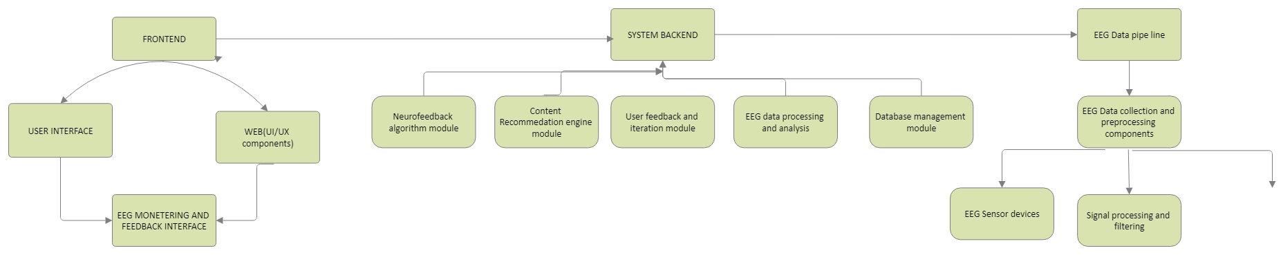
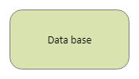
Architecture

Slide 6
Pseudo Code
COLLECTION OF DATA
# Function to get EEG data for ourproject
function load_eeg_data():
# Implement logic to load EEG data
return eeg_data
EXTRACTION OF FEATURES FROM DATA
# Function to extract features from EEG data
function extract_features(eeg_data):
# Implement feature extraction logic
return features

Slide 7
SPLITTING OF DATA
# Function to split data into training and testing sets
function split_data(features, labels):
# Implement logic to split data
return X_train, X_test, y_train, y_test
STANDARDIZE FEATURES
# Function to standardize features
function standardize_features(features):
# Implement feature standardization logic
return standardized_features
TRAINING THE MODEL
# Function to train a machine learning model
function train_model(X_train, y_train):
# Implement logic to train a model
return model
EVALUATE MODEL
# Function to evaluate the model
function evaluate_model(model, X_test, y_test):
# Implement logic to evaluate the model
return accuracy

Slide 8
# Function to save the trained model
function save_model(model, filename):
# Implement logic to save the trained model
pass
CLUSTERING THE DATA
# Function to apply clustering to EEG data
function apply_clustering(features):
# Implement clustering logic
return clusters
DIAGNOSE BASED ON CLUSTERS
# Function to determine diagnosis based on clusters
function determine_diagnosis(clusters):
# Implement logic to determine diagnosis
return diagnosis
RECOMMENDATIONS
# Function to recommend content based on diagnosis
function recommend_content(diagnosis):
# Implement logic to recommend content
return recommendations

Slide 9
# Function to play recommended content
function play_content(recommendations):
# Implement logic to play recommended content
pass
# Main part of program
eeg_data = load_eeg_data()
features = extract_features(eeg_data)
X_train, X_test, y_train, y_test = split_data(features, labels)
X_train_scaled = standardize_features(X_train)
X_test_scaled = standardize_features(X_test)
model = train_model(X_train_scaled, y_train)
accuracy = evaluate_model(model, X_test_scaled, y_test)
save_model(model, 'mental_health_model.pkl')
clusters = apply_clustering(features)
diagnosis = determine_diagnosis(clusters)
recommendations = recommend_content(diagnosis)
play_content(recommendations)

Slide 10
SWOT Analysis
Strengths
Personalized Experience
Scientific Credibility
Weakness
Learning Curve
Cost Barrier
Opportunities:
Market Growth
Collaborations
Threats
Competition
Privacy Concerns

Slide 11
THANK YOU

